Slide 1
Improvements to Polynomial Multiplication Through Fast Fourier Transforms
David Lambropoulos
Demetrios Lambropoulos

Slide 2
Contents
Introduction/Motivation
Theory/Algorithms
Experimental Setup
Results and Analysis
Discussion

Slide 3
Contents
Introduction/Motivation
Theory/Algorithms
Experimental Setup
Results and Analysis
Discussion

Slide 4
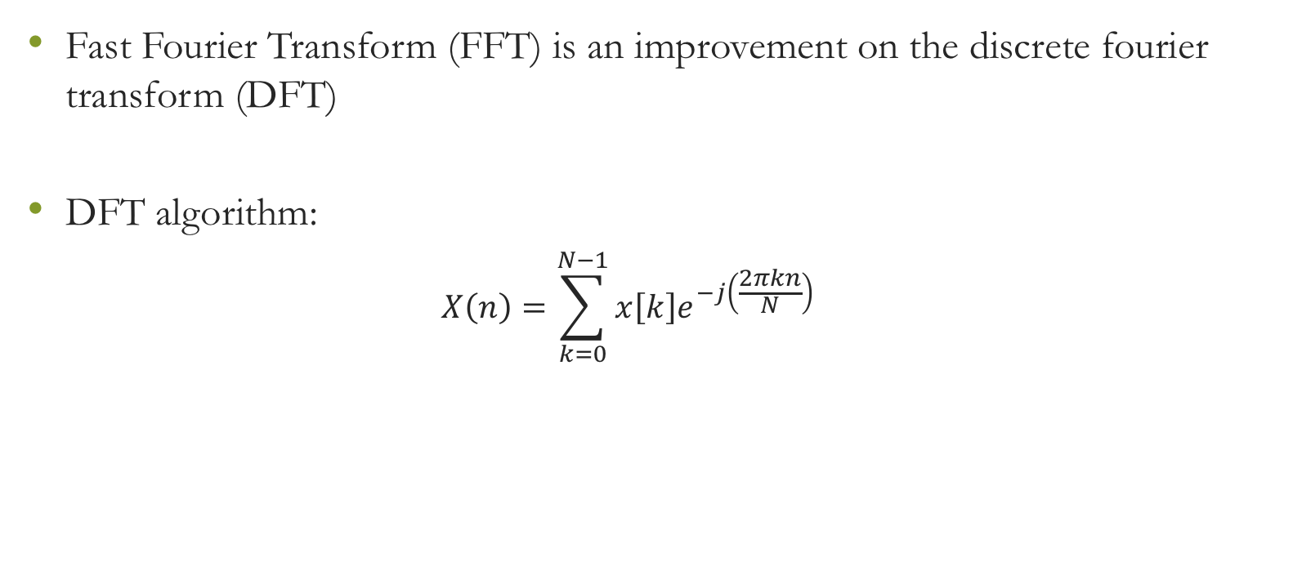
Introduction/Motivation
Fast Fourier Transform (FFT) is an improvement on the discrete fourier transform (DFT)
DFT algorithm:
$$X\left(n\right)=\sum_{k=0}^{N−1}{x\left[k\right]e^{−j\left(\frac{2πkn}{N}\right)}}$$

Slide 5
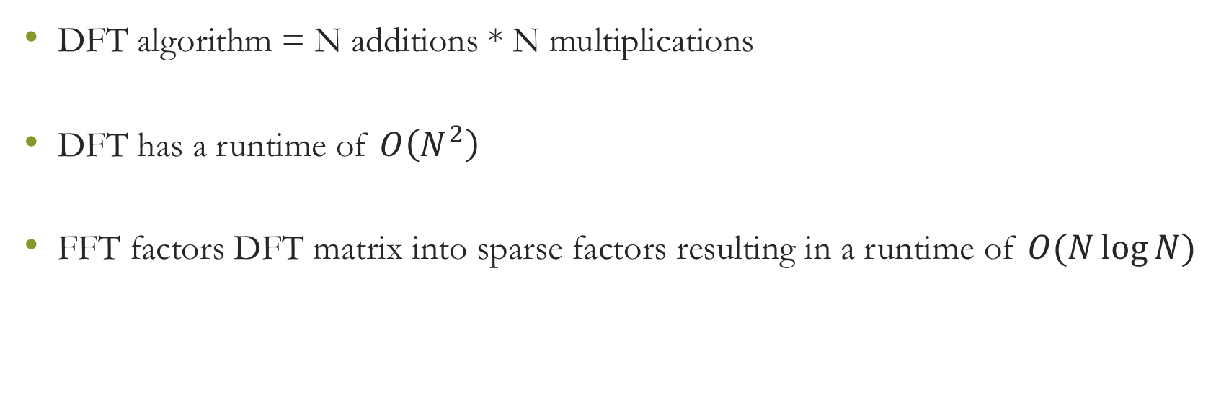
Introduction/Motivation
DFT algorithm = N additions * N multiplications
DFT has a runtime of $O\left(N^{2}\right)$
FFT factors DFT matrix into sparse factors resulting in a runtime of $O(N\log{N})$

Slide 6
Introduction/Motivation
Scientific motivation
Solving large polynomial multiplication by hand is tedious and error prone
Solving large polynomial multiplications through quadratic algorithms would cost too much time

Slide 7
Contents
Introduction/Motivation
Theory/Algorithms
Experimental Setup
Results and Analysis
Discussion

Slide 8
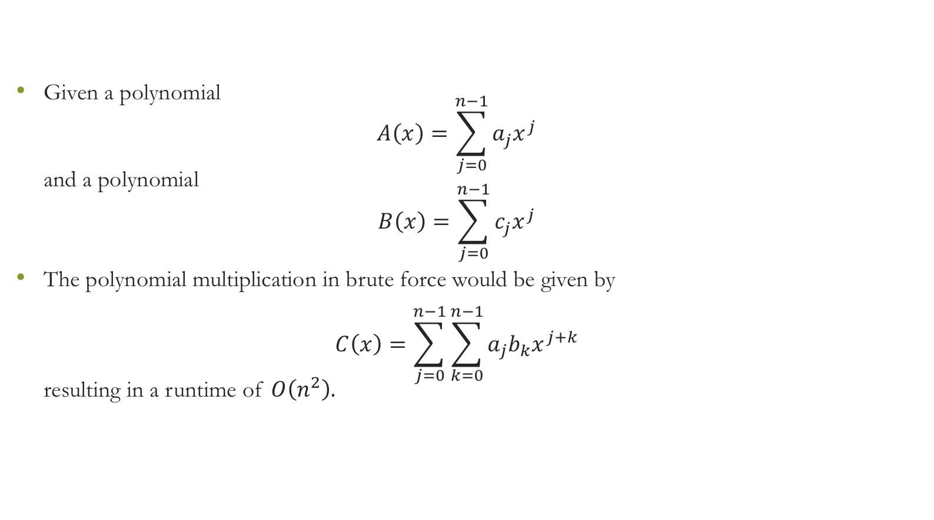
Theory/Algorithms – Brute Force
Given a polynomial $A\left(x\right)=\sum_{j=0}^{n−1}{a_{j}x^{j}}$ and a polynomial $B\left(x\right)=\sum_{j=0}^{n−1}{c_{j}x^{j}}$
The polynomial multiplication in brute force would be given by $C\left(x\right)=\sum_{j=0}^{n−1}{\sum_{k=0}^{n−1}{a_{j}b_{k}x^{j+k}}}$ resulting in a runtime of $O\left(n^{2}\right).$

Slide 9
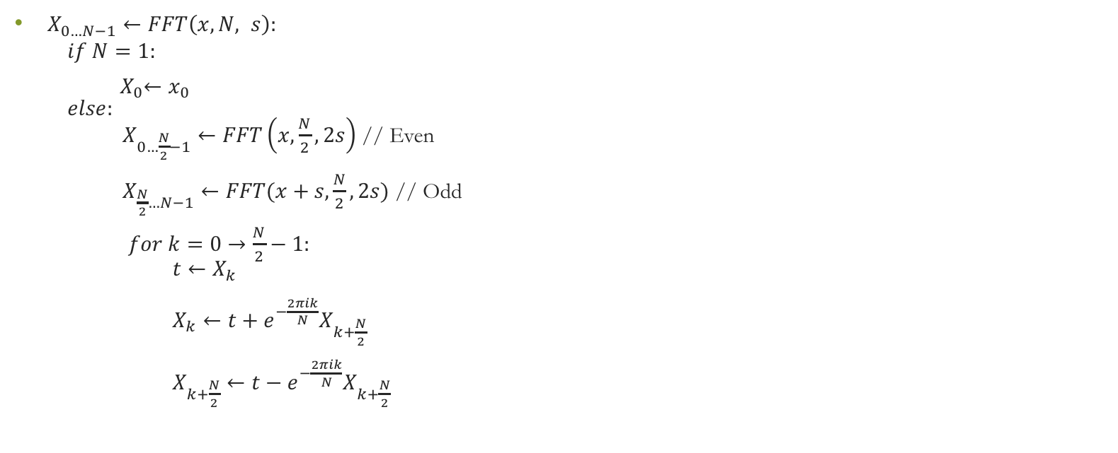
Theory/Algorithms – Fast Fourier Transform
$X_{0…N−1}←FFT\left(x, N, s\right):$ $if N=1:$
${ X}_{0}←x_{0}$ $else:$ $X_{0…\frac{N}{2}−1}←FFT\left(x,\frac{N}{2}, 2s\right)$ // Even $X_{\frac{N}{2}…N−1}←FFT(x+s,\frac{N}{2}, 2s)$ // Odd
$for k=0→\frac{N}{2}−1:$ $t←X_{k}$ $X_{k}←t+e^{−\frac{2πik}{N}}X_{k+\frac{N}{2}}$ $X_{k+\frac{N}{2}}←t−e^{−\frac{2πik}{N}}X_{k+\frac{N}{2}}$

Slide 10
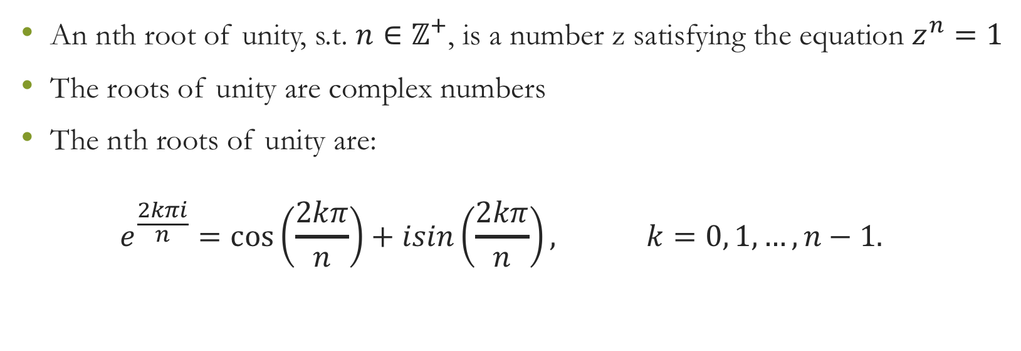
Theory/Algorithms – Roots of Unity
An nth root of unity, s.t. $n∈ℤ^{+}$, is a number z satisfying the equation $z^{n}=1$
The roots of unity are complex numbers
The nth roots of unity are: $e^{\frac{2kπi}{n}}=\cos\left(\frac{2kπ}{n}\right)+isin\left(\frac{2kπ}{n}\right), k=0, 1, …, n−1.$

Slide 11
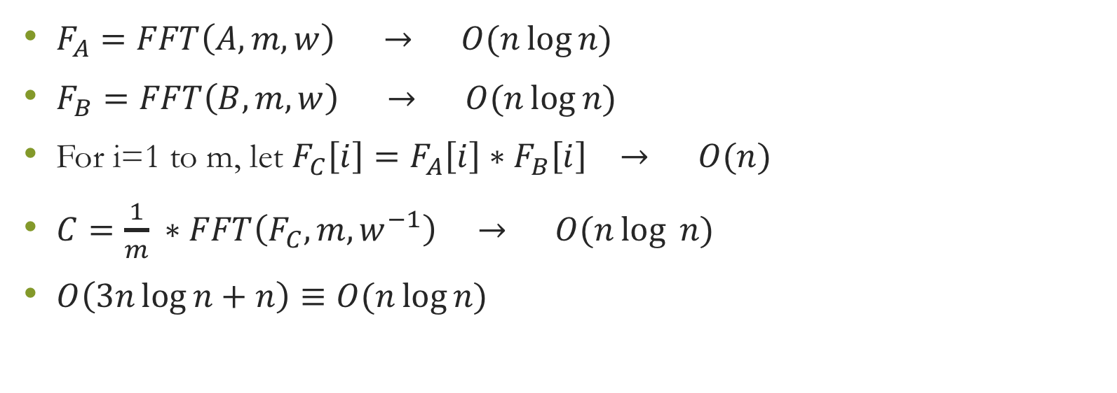
Theory/Algorithms – Final Algorithm
$F_{A}=FFT\left(A, m, w\right) → O(n\log{n)}$
$F_{B}=FFT\left(B, m, w\right) → O(n\log{n})$
For i=1 to m, let $F_{C}\left[i\right]=F_{A}\left[i\right]∗F_{B}\left[i\right] → O(n)$
$C=\frac{1}{m} ∗FFT\left(F_{C}, m, w^{−1}\right) → O(n\log{ n})$
$O\left(3n\log{n}+n\right)≡O(n\log{n})$

Slide 12
Contents
Introduction/Motivation
Theory/Algorithms
Experimental Setup
Results and Analysis
Discussion

Slide 13
Experimental Setup
Datasets of random-valued n-degree polynomials were generated
Datasets ranged from sizes n=64, 128, 256, 512, 1024, 2048, 4096, and 8192
The experiment was run on Windows (Processor Intel® Core™ i7-3630QM CPU @ 2.40GHz, 2401 Mhz, 4 Core(s), 8 Logical Processor, 8GB RAM) running Windows 10

Slide 14
Contents
Introduction/Motivation
Theory/Algorithms
Experimental Setup
Results and Analysis
Discussion

Slide 15
Results and Analysis

Slide 16
Results and Analysis

Slide 17
Contents
Introduction/Motivation
Theory/Algorithms
Experimental Setup
Results and Analysis
Discussion

Slide 18
Discussion
At first it would appear that the FFT offers less advantage with smaller degree polynomials, but easily offers vast as the polynomial degree increases

